Slide 1
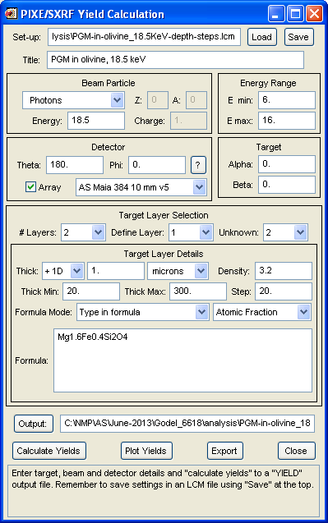
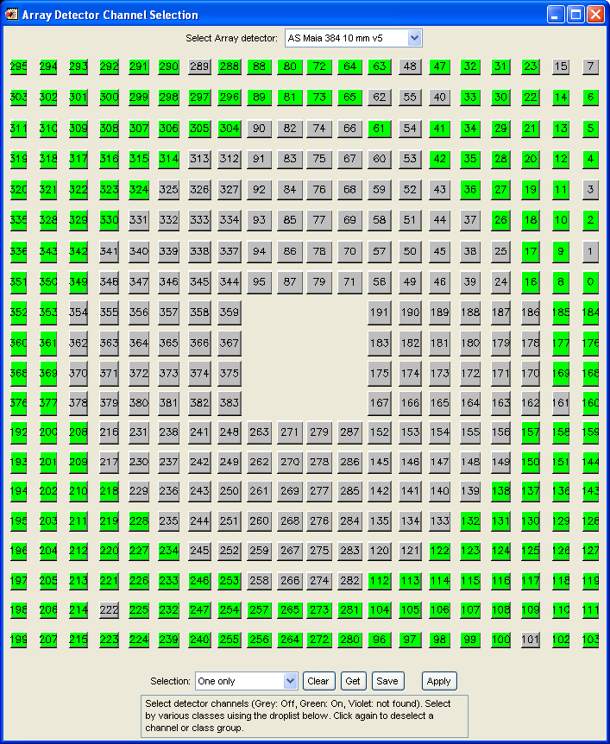
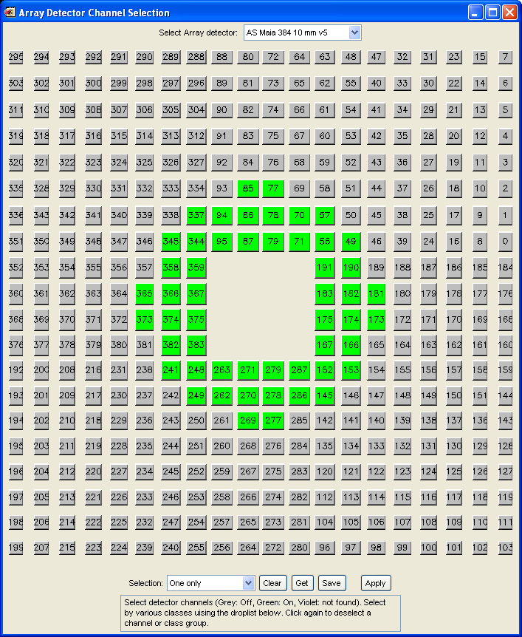
Beam
Maia detector
Inner
Outer
Layer #1
Sample
Layer #2
Outer
Inner

